Slide 1

Finding the best models
(statistics, probability, and magic)
Prof. Dominic Evangelista
Adelphi University

Slide 2
Overview
Criteria for evaluating models
Parsimony
Predictive ability
Realism
Frameworks for evaluating models
Parsimony
Likelihood
Bayesian
Algorithms for searching for the best parameters
MCMC
“Hueristics”

Slide 3
What makes a good model?
Simplicity
Predictive ability
Realism

Slide 4
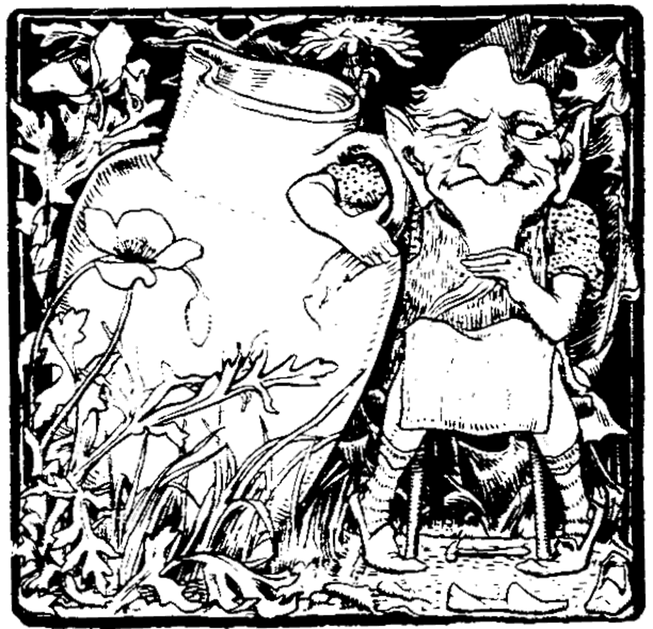
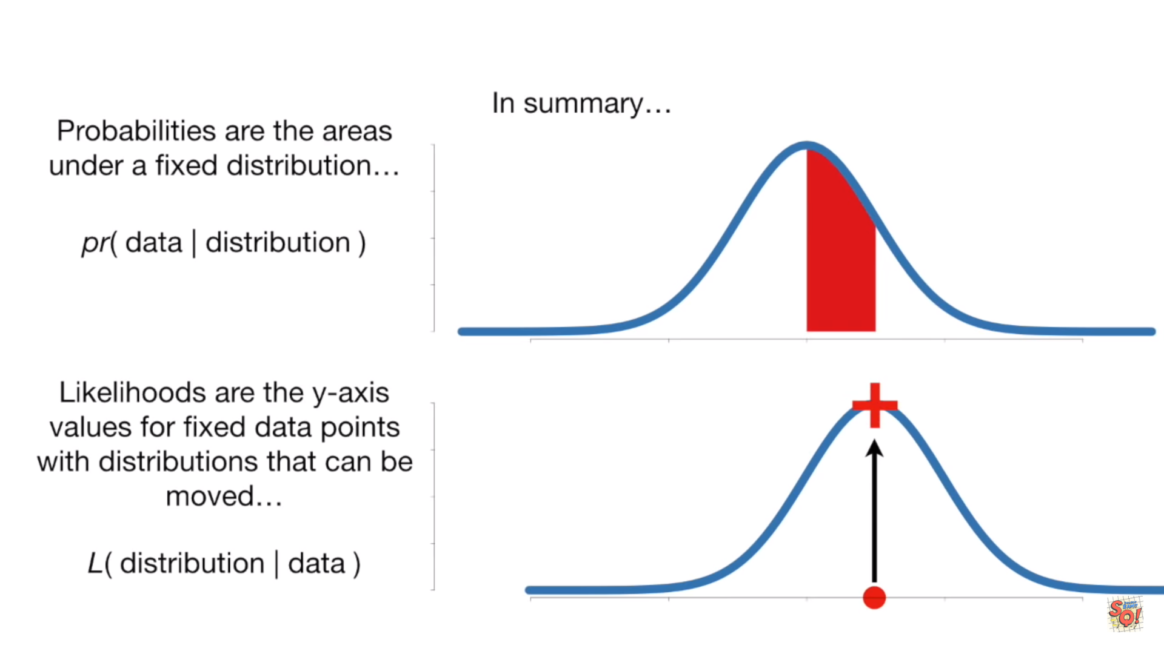
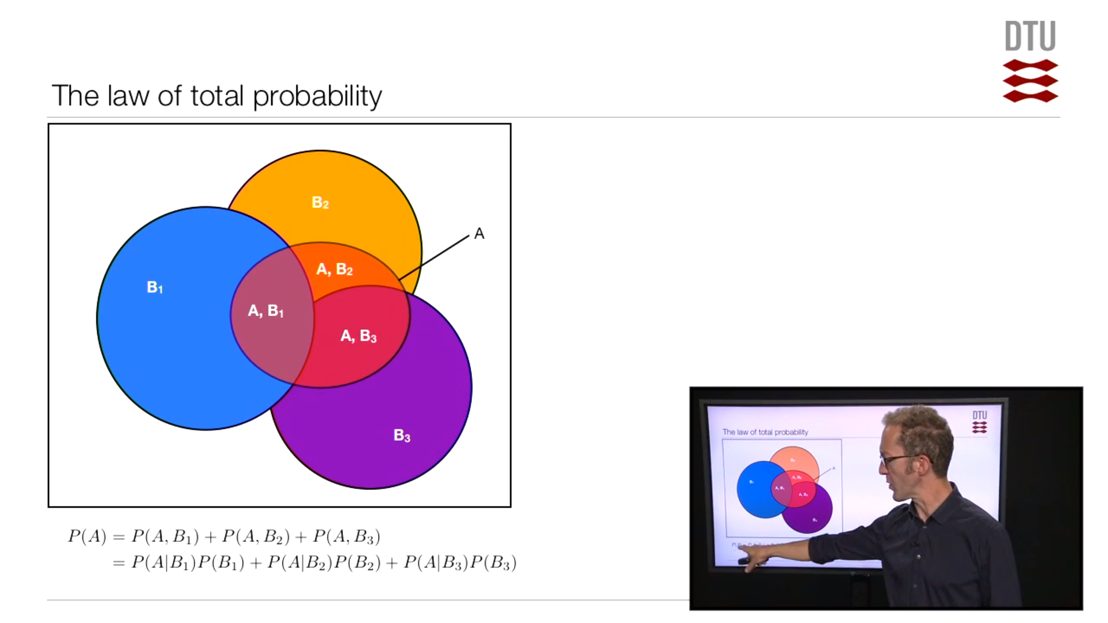

Slide 5
Occam’s Razor
(parsimony)
The simplest explanation is always the best explanation.
EX:
Why is _______ wearing red shoes?

Slide 6
Why are you wearing red shoes?

Slide 7
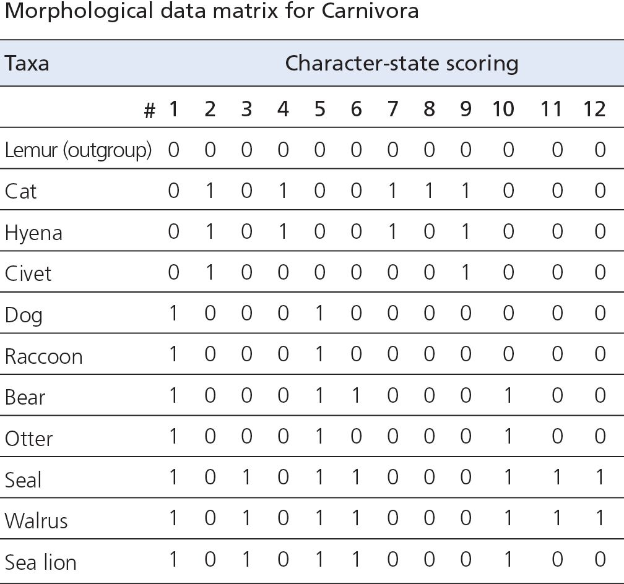
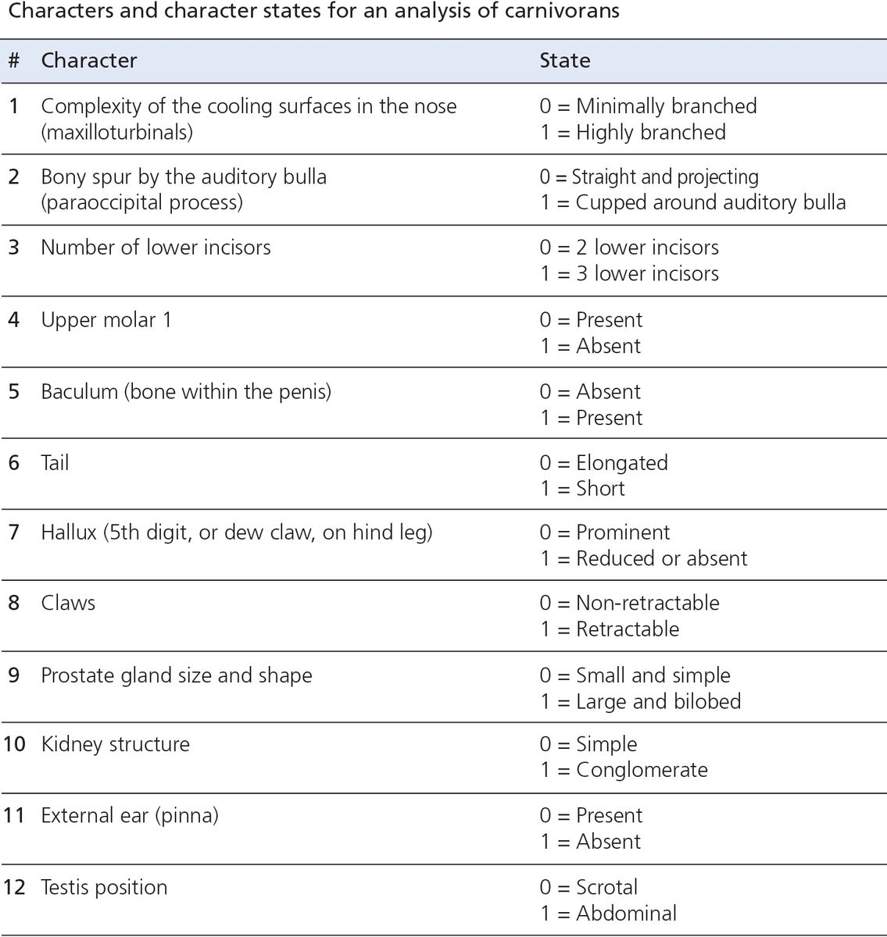
Why parsimony is useful
It provides a computationally simple way of determining evolutionary relationships.

Slide 8
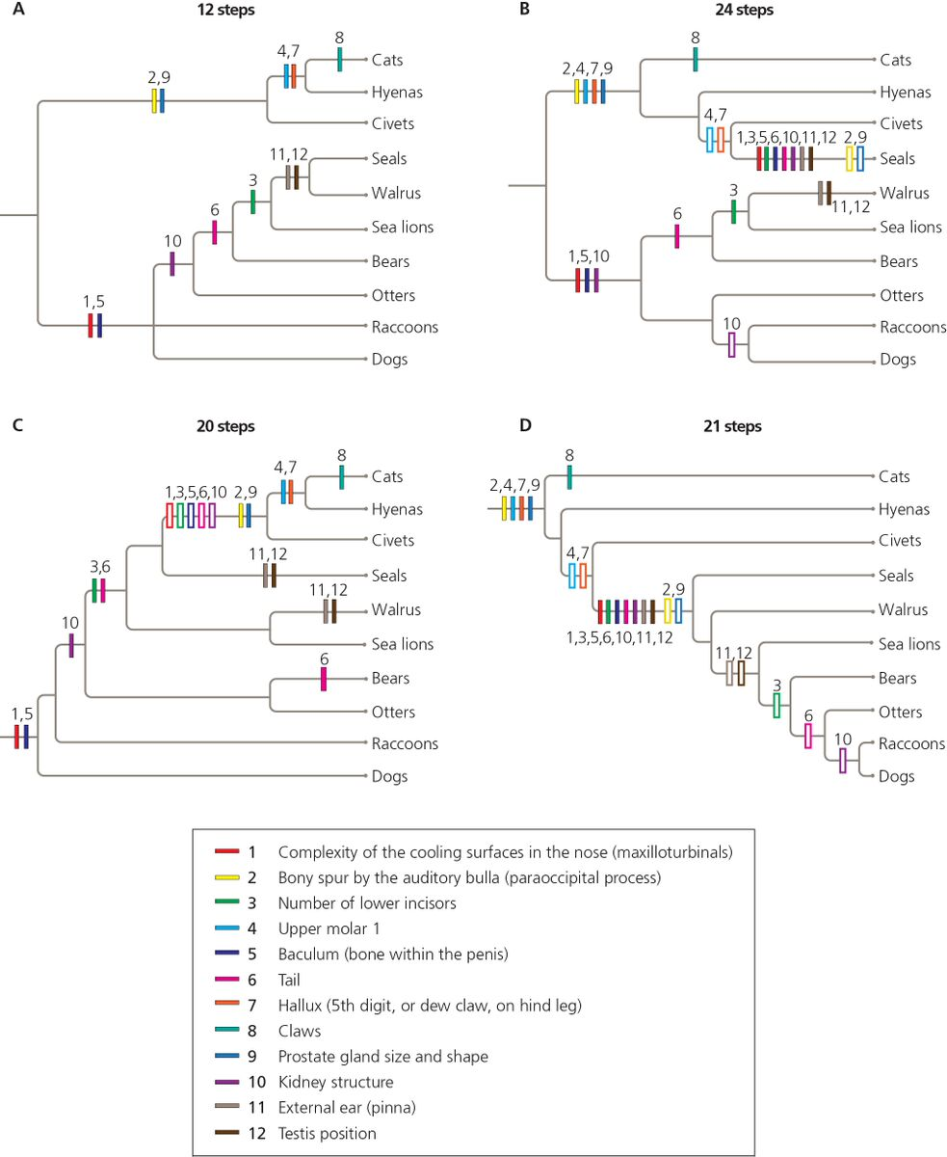
Notes:
Tree is a Hypothesis
Trees require different numbers of evolutionary change.
Tree A requires fewer evolutionary steps to explain the data than do the others, each character evolved just a single time, so it’s considered the most parsimonious tree.
Solid bar = ancestral to derived
Open bar = derived to ancestral

Slide 9
Why parsimony is useful
It provides a computationally simple way of determining evolutionary relationships.
Problem: When there is real homoplasy and real noise it makes errors. Because homoplasy and noise are not parsimonious but they happen in the real world.

Slide 11
Likelihood – how reasonable a model (e.g., distribution) is given observations
Takes parsimony into consideration.

Slide 12
Maximum Likelihood – The optimal fit of a model to a dataset under the criteria of likelihood (or, more commonly, log-likelihood).

Slide 13
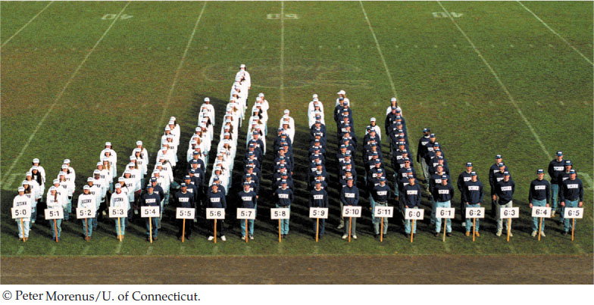
Maximizing likelihood
Problem: What model (statistical distribution) fit data for heights best?
If we know what distribution determines
Human heights, then it can give us some
Information about the genetic and
Developmental determinants of human
height

Slide 14
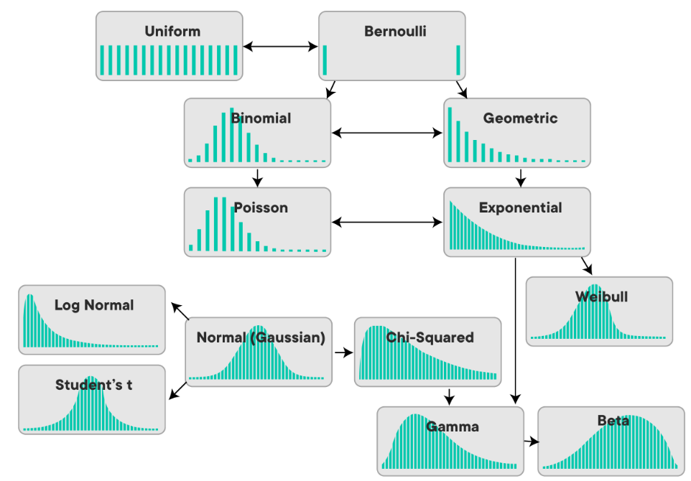
Maximizing likelihood
Problem: What model (statistical distribution) fit data for heights best?
Types of distributions

Slide 15
Maximizing likelihood
Height is a continuous variable, so requires a continuous distribution
Types of distributions

Slide 16
Maximizing likelihood
Height is a continuous variable, so requires a continuous distribution.
Some distributions are more flexible, and more common than others, so we can narrow down the possibilities even more.
Types of distributions

Slide 17
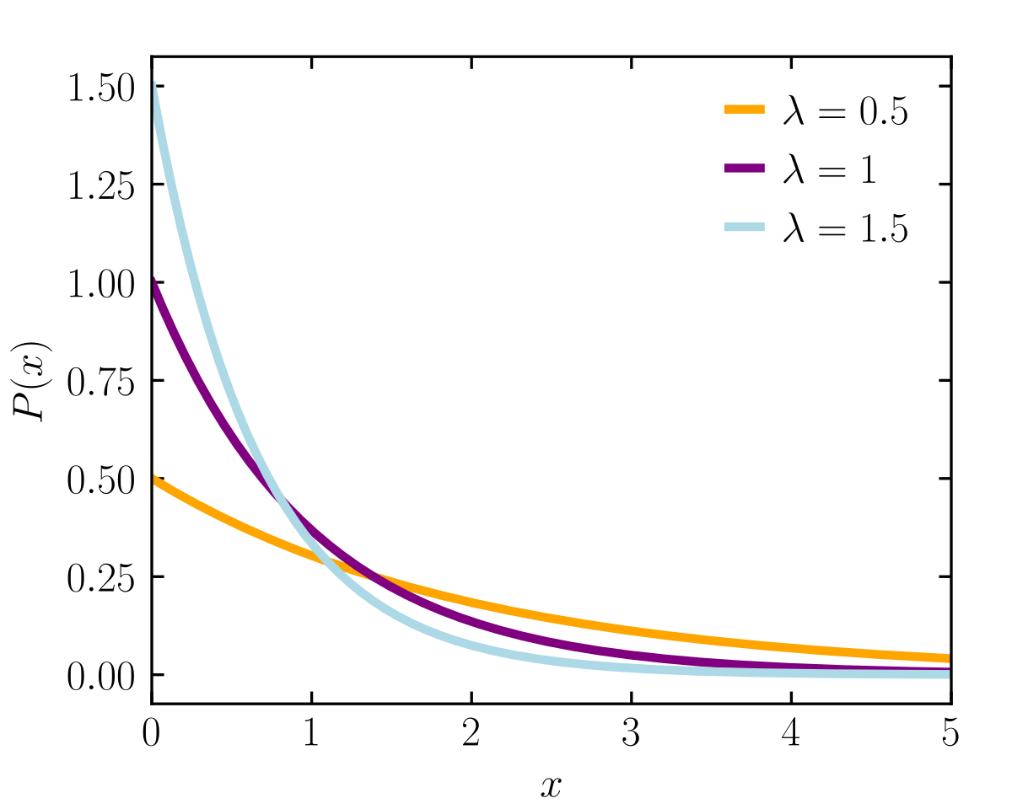
Maximizing likelihood
Does our data fit an exponential distribution?

Slide 18
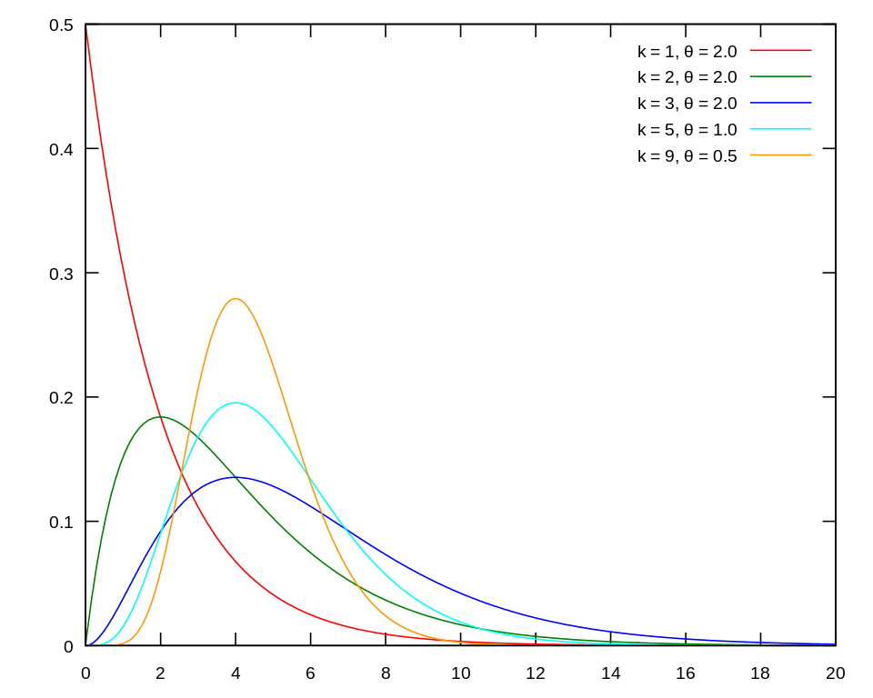
Maximizing likelihood
Does our data fit a gamma distribution?

Slide 19
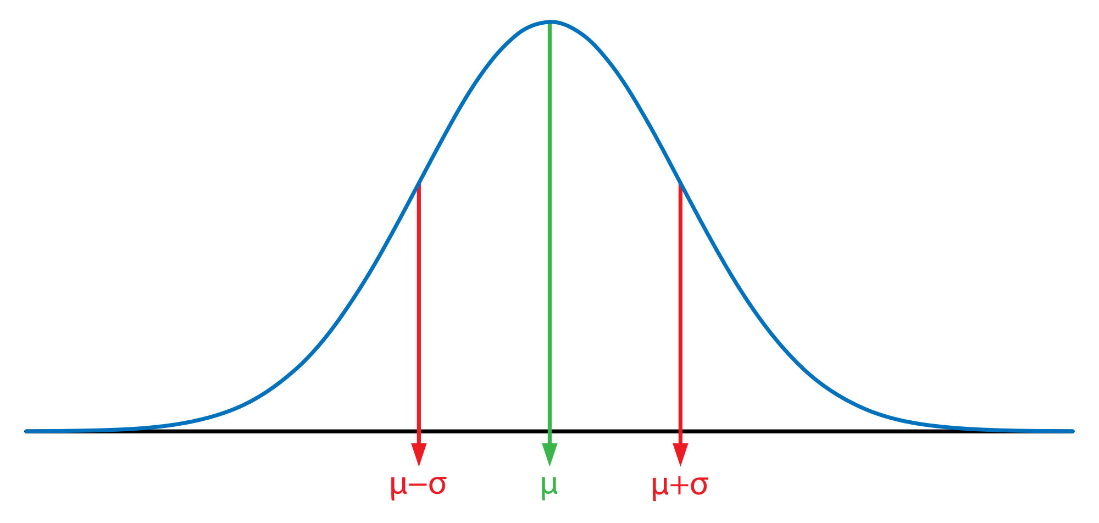
Maximizing likelihood
Does our data fit a normal distribution?

Slide 20
Maximizing likelihood
How to find out?
Test each distribution against the data by calculating the likelihood and then choosing the result with the maximum likelihood.

Slide 21
Maximizing likelihood
Likely normally distributed.

Slide 22
Maximizing likelihood
Likely normally distributed, but with what parameter values?

Slide 23
Maximizing likelihood
Normal distribution has two parameters
Mean
Standard deviation

Slide 24
Maximizing likelihood
Normal distribution has two parameters
Mean
Standard deviation
How to find out?
-Calculate it (not always possible)
-MCMC

Slide 25
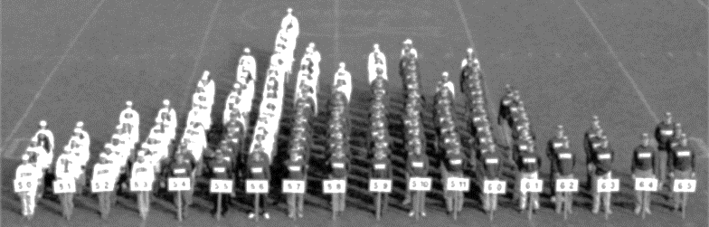
MCMC for maximizing likelihood estimation
Step 1: Randomly pick a mean for the distribution.
Step 2: Calculate likelihood.
Step 3: Repeat with a new mean close to the previous mean.

Slide 26
MCMC for maximizing likelihood estimation
Step 1: Randomly pick a mean for the distribution.
Step 2: Calculate likelihood.
Step 3: Repeat with a new mean close to the previous mean.

Slide 27
MCMC for maximizing likelihood estimation
Step 1: Randomly pick a mean for the distribution.
Step 2: Calculate likelihood.
Step 3: Repeat with a new mean close to the previous mean.

Slide 28
MCMC for maximizing likelihood estimation
Step 1: Randomly pick a mean for the distribution.
Step 2: Calculate likelihood.
Step 3: Repeat with a new mean close to the previous mean.

Slide 29
MCMC for maximizing likelihood estimation
Step 1: Randomly pick a mean for the distribution.
Step 2: Calculate likelihood.
Step 3: Repeat with a new mean close to the previous mean.

Slide 30
MCMC for maximizing likelihood estimation
Step 1: Randomly pick a mean for the distribution.
Step 2: Calculate likelihood.
Step 3: Repeat with a new mean close to the previous mean.

Slide 31
MCMC for maximizing likelihood estimation
Step 1: Randomly pick a mean for the distribution.
Step 2: Calculate likelihood.
Step 3: Repeat with a new mean close to the previous mean.

Slide 32
MCMC for maximizing likelihood estimation
Step 1: Randomly pick a mean for the distribution.
Step 2: Calculate likelihood.
Step 3: Repeat with a new mean close to the previous mean.

Slide 33
MCMC for maximizing likelihood estimation
Step 3+i: Repeat, calculating the likelihood again every time.
Final step: Apply stopping criterion and accept the value that maximized the likelihood.

Slide 34
Markov chain Monte Carlo (simulation)

Slide 35
Markov chain Monte Carlo (simulation)
A randomization simulation.
A process of choosing random values, usually to estimate some unknown value or space.
Example: https://www.youtube.com/watch?v=7ESK5SaP-bc (Watch first three minutes.)

Slide 36
Markov chain Monte Carlo (simulation)
A stochastic (randomish) process where a single randomization is dependent on the one previous step.
A systematic way of using a Monte-Carlo simulation.
Example: https://www.youtube.com/watch?v=7ESK5SaP-bc (Watch first three minutes.)

Slide 37
Markov chain Monte Carlo (simulation)
A randomization simulation where a single randomization is dependent on the one previous step with the goal of estimating an unknown parameter (or series of parameters).
Can you code an MCMC to find the maximum likelihood parameter space of a model?

Slide 38
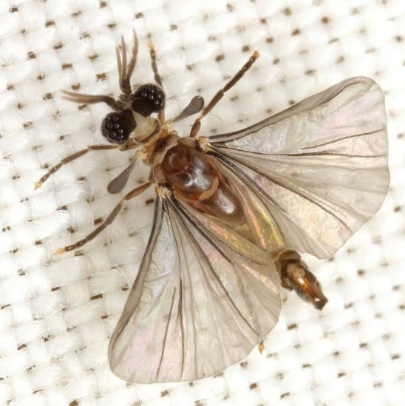
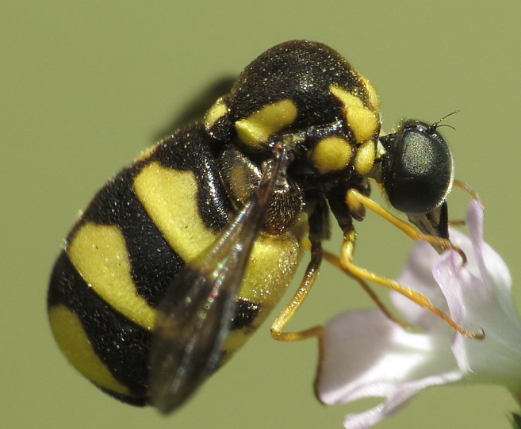
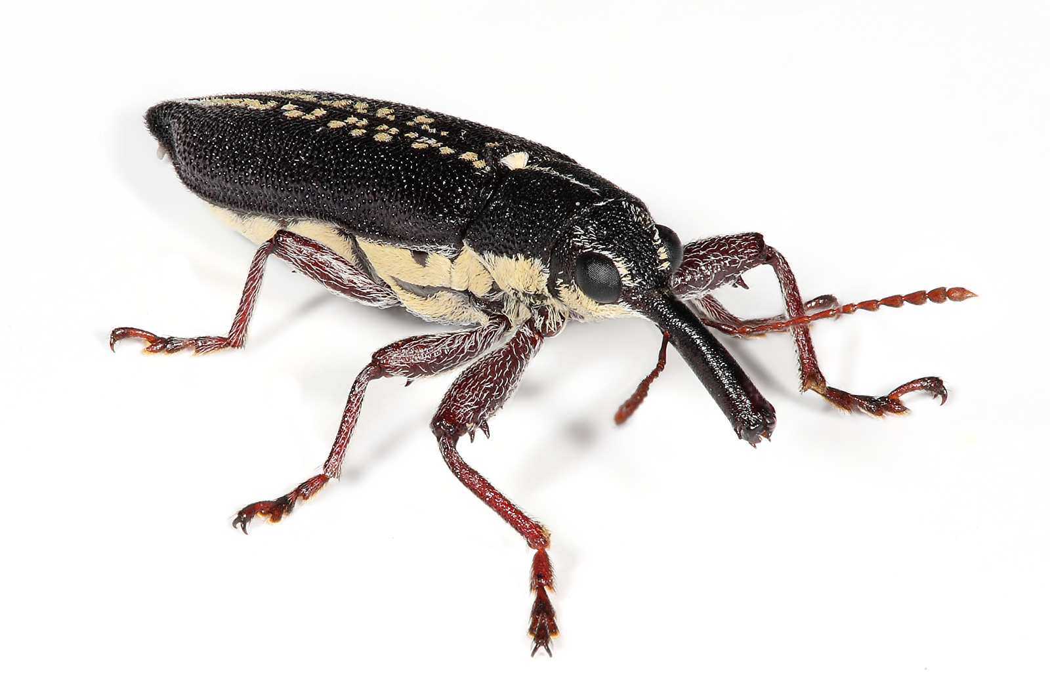
Markov chain Monte Carlo for maximizing the likelihood of a phylogenetic tree (ML MCMC)
Species A
Species B
Species C
If we have three species (A, B & C), how do we know the relationships between them?

Slide 39
Figuring out which hypothesis is best can be one of the most difficult problems in biology
Step 1: Randomly pick a tree
Step 2: Calculate likelihood.
Step 3: Repeat with a new tree similar to the previous tree.
Subtree-Pruning-Regrafting (SPR) Algorithm
A
A
C
B
B
C

Slide 40
Figuring out which hypothesis is best can be one of the most difficult problems in biology
Step 1: Randomly pick a tree
Step 2: Calculate likelihood.
Step 3: Repeat with a new tree similar to the previous tree.
A
Subtree-Pruning-Regrafting (SPR) Algorithm
B
C
C
B
A

Slide 41


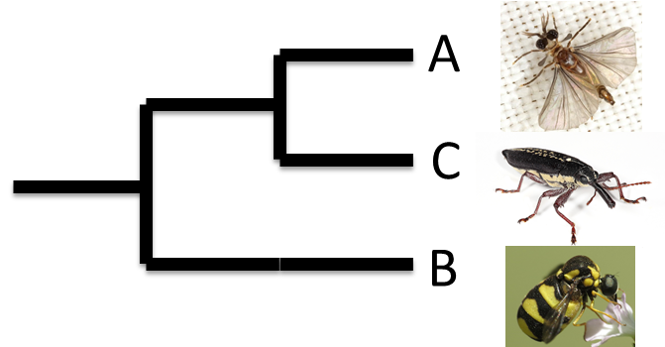
Subtree-Pruning-Regrafting (SPR) Algorithm
(a heuristic)
A
A
C
C
B
B
A
C
B

Slide 42
What is a heuristic and why does it matter?
Figuring out which hypothesis is best can be one of the most difficult problems in biology
A
A
C
B
B
C
B
3 tips in the (rooted) tree
3 different possible trees
C
A

Slide 43
A
A
D
D
D
B
B
C
B
B
C
D
B
C
A
D
C
A
A
C
A
A
D
C
C
C
B
D
A
D
B
B
A
A
4 tips in the (rooted) tree
12 different possible trees
D
D
C
B
B
C
C
C
B
B
A
D
D
A
Notes:
Actually 15 but in this example I am not counting trees with polytomies.

Slide 44
QUESTION: In a tree with 64 tips, the number of possible trees is…
128
4096
64!
a number greater than the number of protons in all of the molecules of the visible universe
5*10¹⁷
Evangelista et al (2019), a Phylogeny of cockroaches has 64 tips (species)
Notes:
Answer: D (the known universe has an estimated 3*10⁸⁰ protons)
The number of possible trees is about 10^105
E. Is the age of the universe in seconds
64!= ~1x10^89
For equation and table: http://carrot.mcb.uconn.edu/mcb396_41/tree_number.html

Slide 45
There are 10¹⁰⁵ total possible trees of 64 species.
The age of the universe is 10⁸⁹ seconds.
If it takes only one-hundred-thousandth of a second for my computer to calculate the likelihood of a single tree, how long would it take to find the maximum likelihood tree?
Evangelista et al (2019), a Phylogeny of cockroaches has 64 tips (species)
Notes:
10^100 seconds or 3*10^92 years or 3*10^83 BILLION YEARS

Slide 46
What is a heuristic and why does it matter?
Without heuristics, solving these kinds of problems (NP hard) would be, literally, impossible.
Evangelista et al (2019), a Phylogeny of cockroaches has 64 tips (species)

Slide 47
Why likelihood is useful
It accounts for homoplasy and noise and therefore makes better trees.
It does this by having a model for evolution that is more complex than simply “characters evolve parsimoniously”.

Slide 48
Non-parsimony models for evolution
Examples:
1 parameter nucleotide models
2 parameter nucleotide models
n parameter nucleotide models
Amino acid models
Codon models
mk model (used for phenotypes/morphology)

Slide 49
Non-parsimony models for evolution
Examples:
1 parameter nucleotide models
2 parameter nucleotide models
n parameter nucleotide models
Amino acid models
Codon models
mk model (used for phenotypes/morphology)

Slide 50
1 parameter nucleotide substitution model
2 parameter nucleotide substitution model
Assumptions:
All nucleotides have the same frequency
All nucleotides are equally likely to be substituted by any other nucleotide
Assumptions:
All nucleotides have the same frequency
Transitions are more likely than transversions
Parameters:
Substitution rate
(Jukes and Cantor 1969)
Parameters:
Transition rate
Transversion rate
(Kimura 1980)

Slide 51
n parameter nucleotide substitution model
These models can be expanded to include all the information we know about DNA function and evolution.
What are some other aspects of DNA we could incorporate into models?

Slide 52
n parameter nucleotide substitution model
These models can be expanded to include all the information we know about DNA function and evolution.
For example
Unequal base compositional bias (HKY85)
Paired based compositional bias (T92)
Purine-purine vs. pyrimidine-pyrimidine substitution bias (TN93)
All nucleotides have their own frequency and substitution rates (GTR)

Slide 53
Bayesian vs. Frequentist statistics
But ML isn’t the most computationally heavy method of finding the best model.
Side note: MCMCs aren’t limited to a likelihood framework.
They can be deployed in a Bayesian framework too.

Slide 54
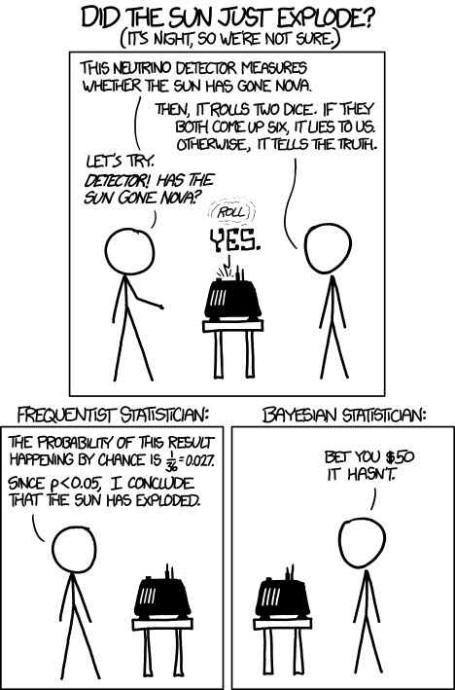

Slide 55

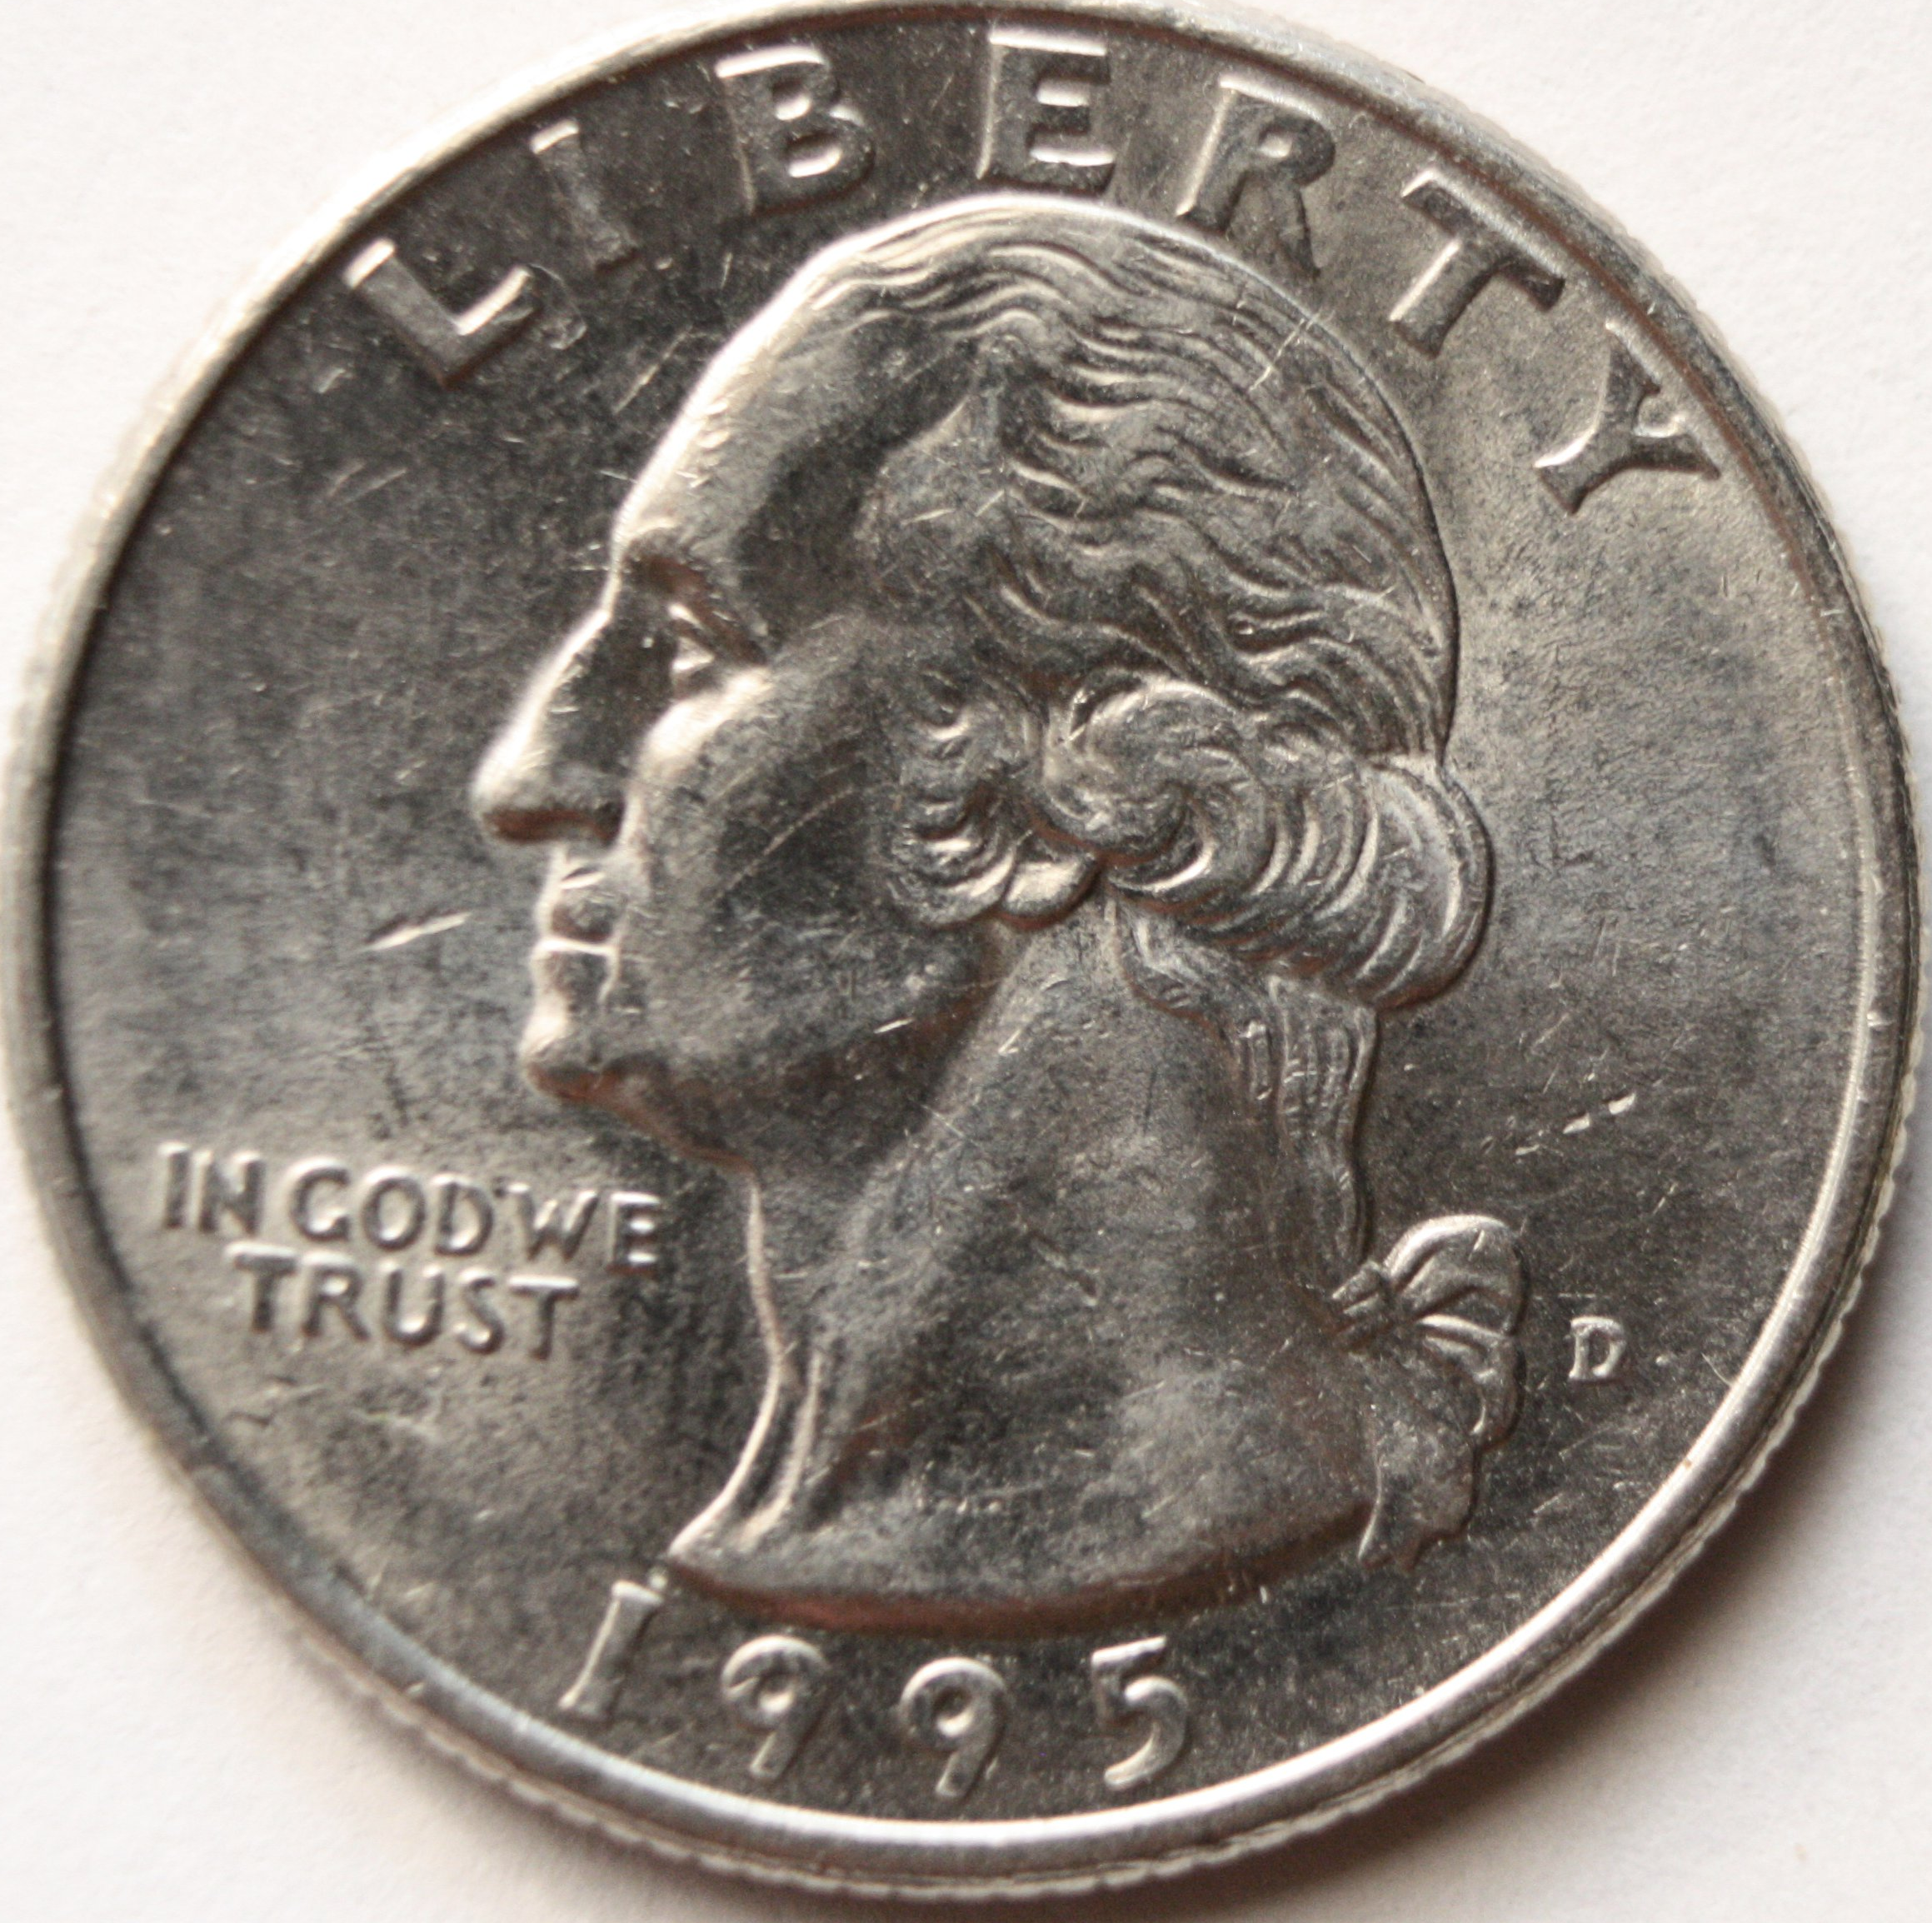
Observation
10x heads
Flipped 10x
Frequentist explanation
Bayesian explanation
You are lucky.

Slide 56
Observation
10x heads
Flipped 10x
Frequentist explanation
Bayesian explanation
(Prior information: Chris is a magician)
You are lucky.
It’s a trick coin.

Slide 57
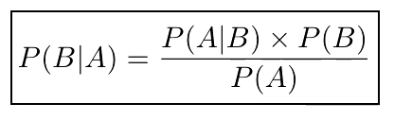
Bayes theorem
Says the (posterior) probability of a model given the data is equal to the likelihood of the data given the model, times the prior probability of the model, divided by the probability of the data.

Slide 58
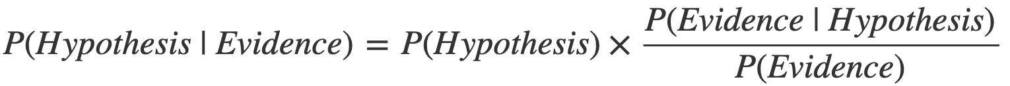
Observation
10x heads
Flipped 10x
Model 1: We’re lucky
Model 2: Trick coin
Likelihood of 10 flips in a row given a trick coin
x
Prior probability of it being a trick coin
Posterior probability that it’s a trick coin given 10-heads flips in a row
=
Probability of 10 coin flips in a row

Slide 59
Observation
10x heads
Flipped 10x
Chris got his coins from a convenience store
Model 1: We’re lucky
Model 2: Trick coin
x
Posterior probability that it’s a trick coin given 10-heads flips in a row
0.50
0.000001
5*10⁻¹⁰
=
=
0.001

Slide 60
Observation
10x heads
Flipped 10x
Chris is a YouTube magician
Model 1: We’re lucky
Model 2: Trick coin
x
Posterior probability that it’s a trick coin given 10-heads flips in a row
0.50
0.001
0.50
=
=
0.001

Slide 61
Do you get the joke now? >

Slide 62
Ways of thinking about probability
Frequentist “probability”– the proportion of times we can expect an event to happen
Bayesian “probability” – degree of belief; quantification of uncertainty

Slide 63
Why Bayesian statistics is important
We want to be able to incorporate prior information in our calculations.
What information could we incorporate as a prior in a Bayesian framework?

Slide 64
Visual guide to Bayesian thinking: https://www.youtube.com/watch?v=BrK7X_XlGB8
Bayesian statistics
https://www.youtube.com/watch?v=DI3TIx78NqM&t=902s

Slide 65
Why Bayesian statistics is important
We want to be able to incorporate prior information in our calculations.
Examples of prior information:
- The fossil record
- Mass extinction events
- Speciation/extinction rate
- Substitution rate
etc.
What makes a good model?
Simplicity
Predictive ability
Realism

Slide 66
Modelling biological patterns
Phylogenetic relationships
Morphological change
Ancestral states
Divergence times

Slide 67
Modelling biological patterns
Phylogenetic relationships
Morphological change
Ancestral states
Divergence times

Slide 68
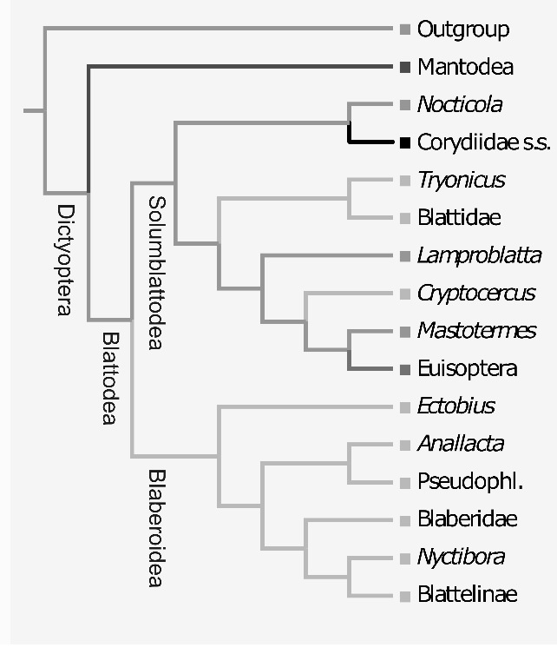
Review question:
Which circle indicates the cladogenesis speciation event that lead to the clade containing Blattidae and Cryptocercus?
C
D
A
B
E
Notes:
Answer: B

Slide 69
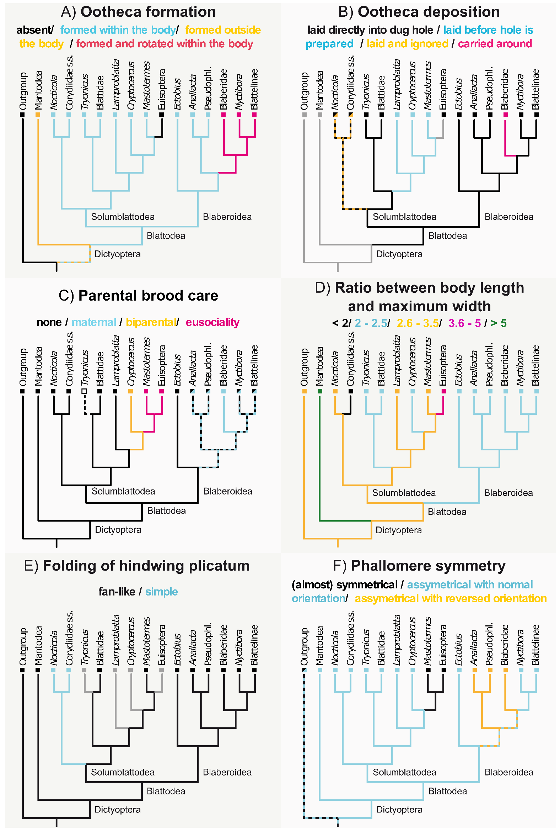
Phylogeny is assumed/
given
Data on extant species is assumed/given
Data on ancestors is calculated
Ancestral state reconstruction uses a tree as part of the data.

Slide 70
In this example the calculation is done with parsimony. However, other criteria can be used (e.g., likelihood or Bayesian posterior probability).
Parsimony = the ancestral state reconstruction with the fewest number of character changes is the best. Therefore, the characters don’t change along branches, but at nodes.
Data on ancestors is calculated

Slide 71
Other methods allow characters to change along branches.
What model is used to change characters along branches?
Brownian motion
Species A – 10 cm
Species B – 9 cm
Species C – 10 cm
Species D – 5 cm

Slide 72
Brownian motion
Brownian motion is a “random walk” model. The rules are that values change by stepping in a random direction away from the current value
Species A – 10 cm
Species B – 9 cm
Species C – 10 cm
Species D – 5 cm

Slide 73
Brownian motion
Brownian motion is a “random walk” model. The rules are that values change by stepping in a random direction away from the current value
Species A – 10 cm
Species B – 9 cm
Species C – 10 cm
Species D – 5 cm
0.1 cm
5 cm
10 cm

Slide 74
Brownian motion
Simulated 1000 times & then averaged
Species A – 10 cm
Species B – 9 cm
Species C – 10 cm
Species D – 5 cm
Species A – 10 cm
Species B – 9 cm
Species C – 10 cm
Species D – 5 cm
7.5cm
0.1 cm
5 cm
10 cm

Slide 75
Given the phylogenetic relationships between the species, which of the following are possible phylogenetic relationships between genes in these species?
Species A
Species B
Species C
Species D
A
B
C
Gene A1
Gene B1
Gene C1
Gene D1
Gene B1
Gene A1
Gene C1
Gene D1
Gene A1
Gene B1
Gene D1
Gene C1
D
Gene D1
Gene B1
Gene C1
Gene A1
E – All are possible

Slide 76
Modelling biological patterns
Phylogenetic relationships
Morphological change
Ancestral states
Divergence times

Slide 77
Modelling divergence time
Time = Distance/Velocity

Slide 78
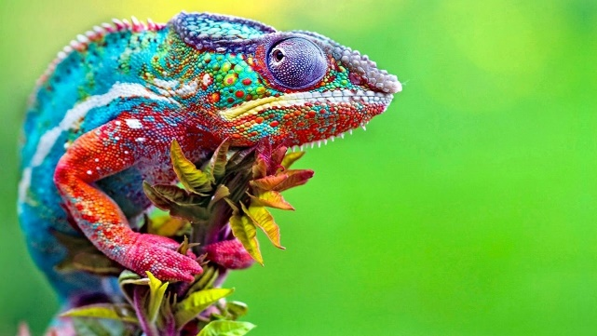
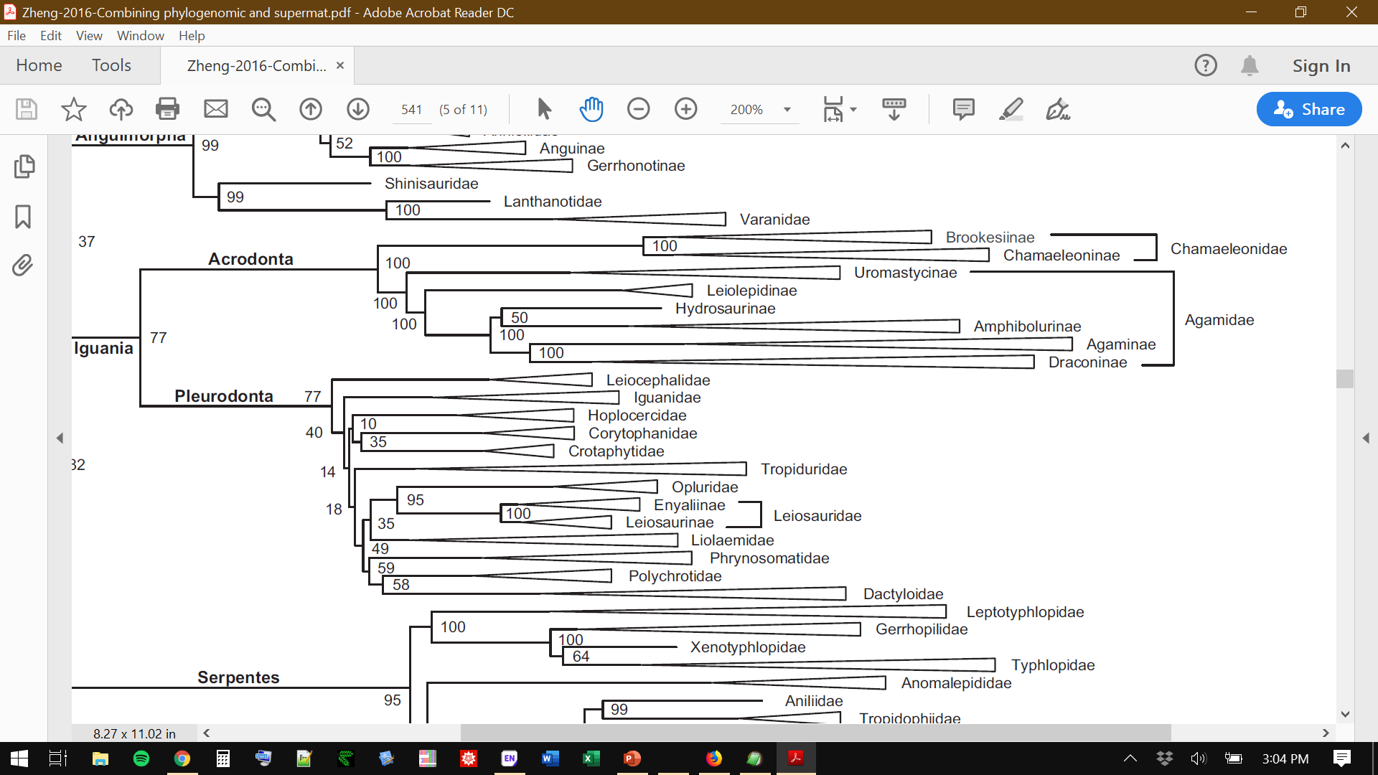
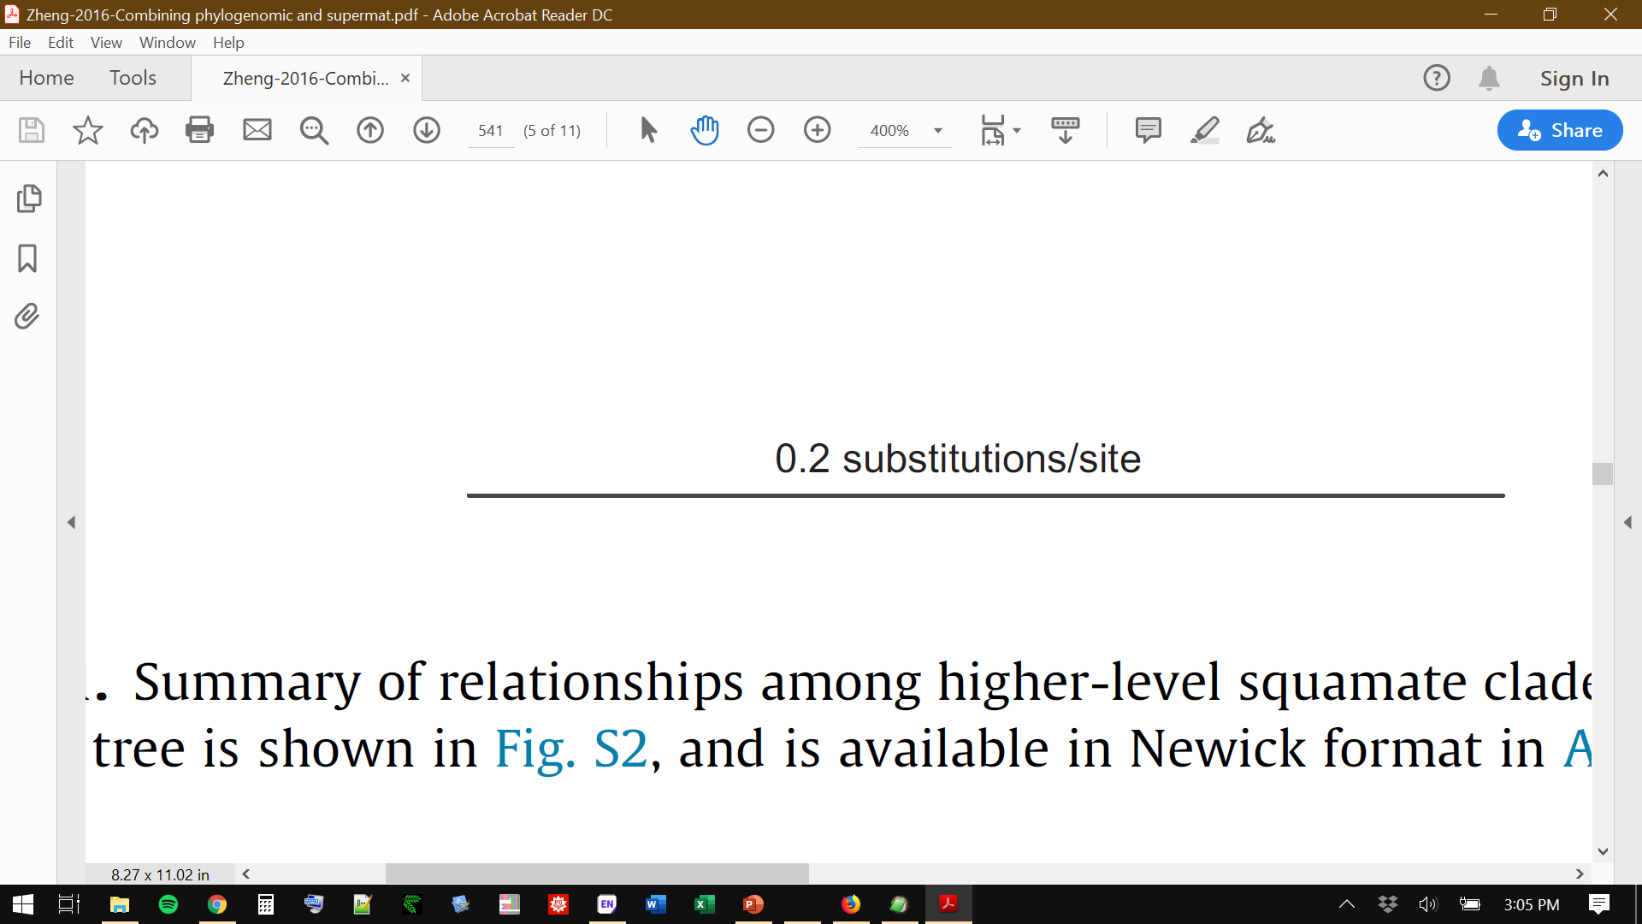
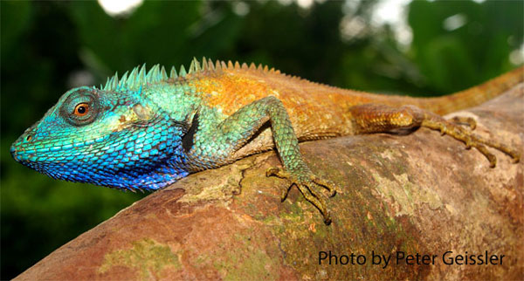
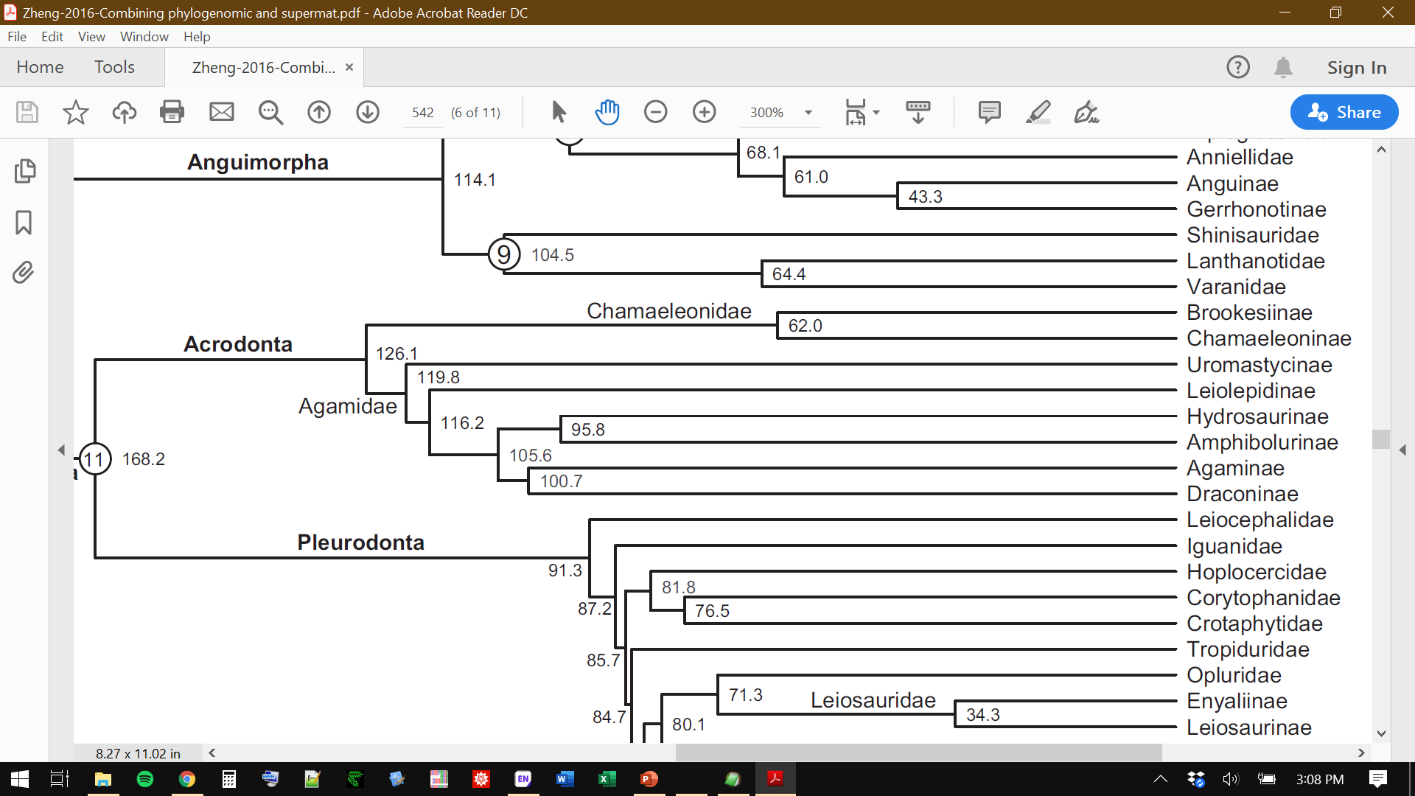
Time = Distance/Velocity
We can use the branch length between two clades as a measure of “evolutionary distance”.

Slide 79
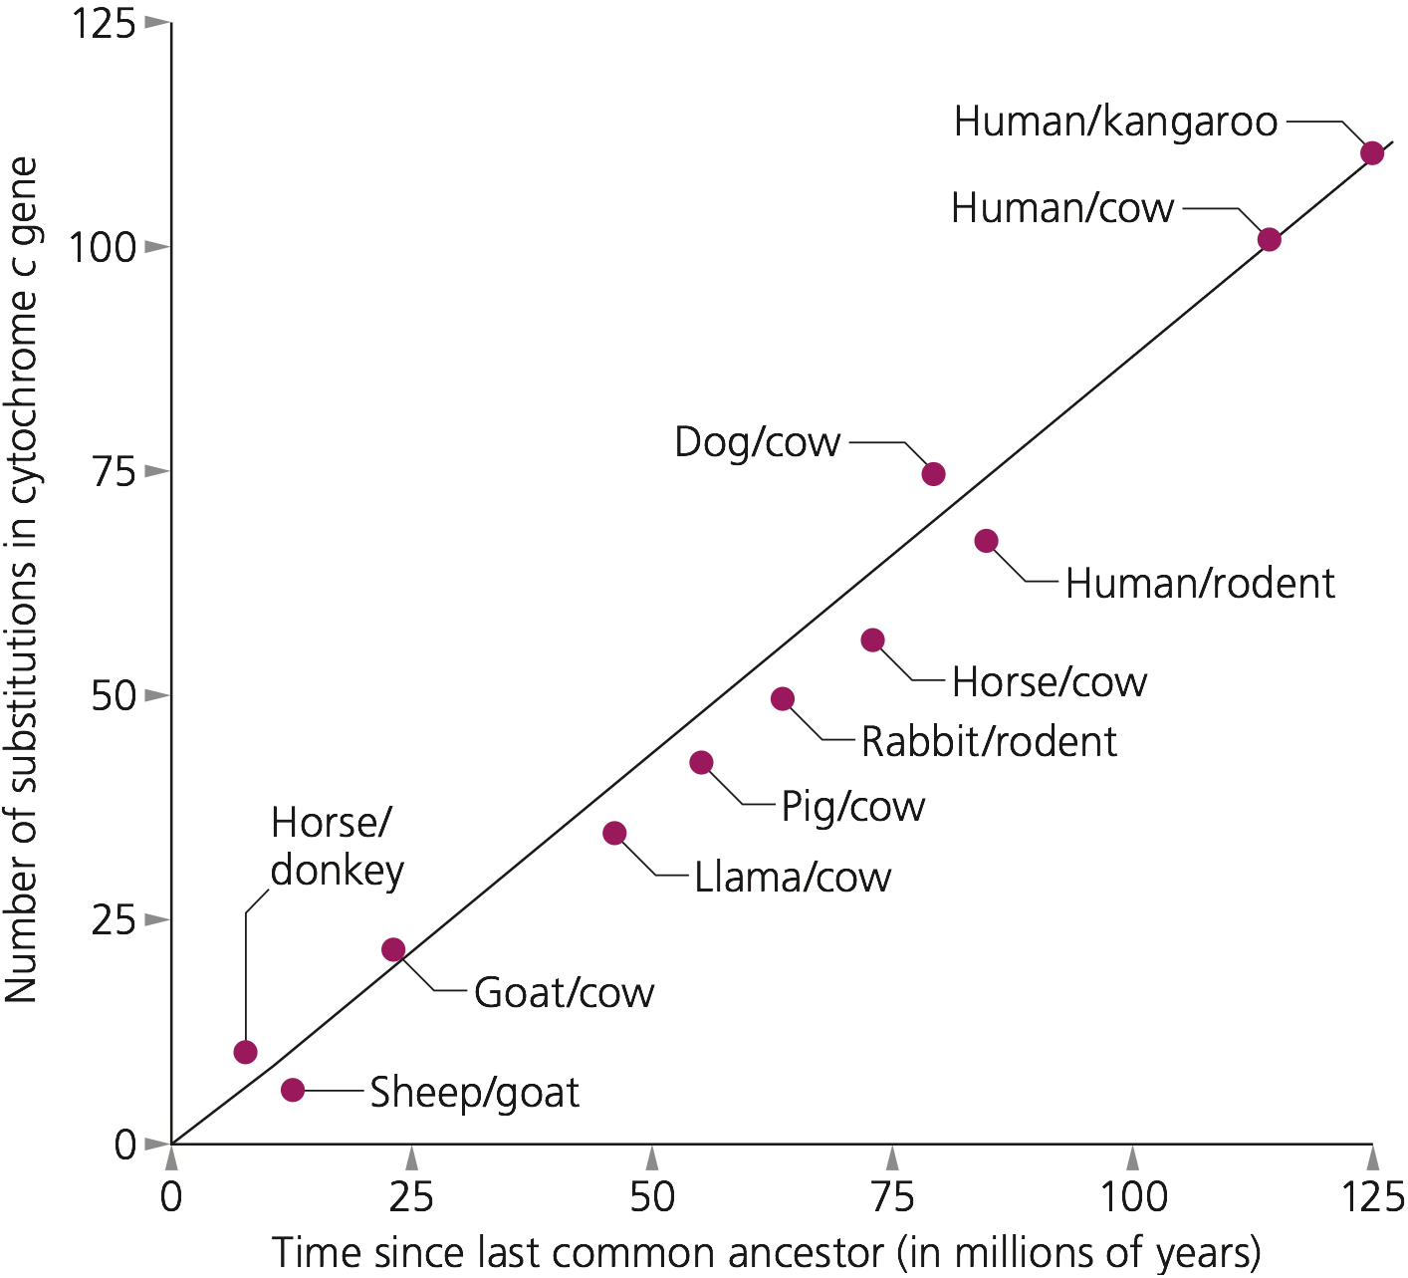
Time = Distance/Velocity
There is evidence of a steady rate of substitution over time.
Caveat: each gene domain may have its own rate.

Slide 80
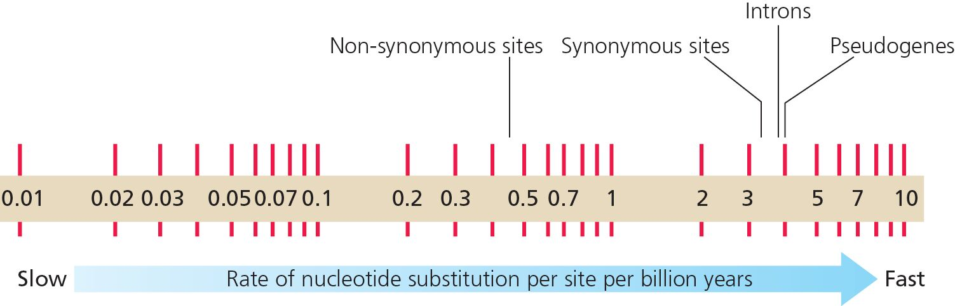
Rate of evolution in different types of DNA does differ

Slide 81
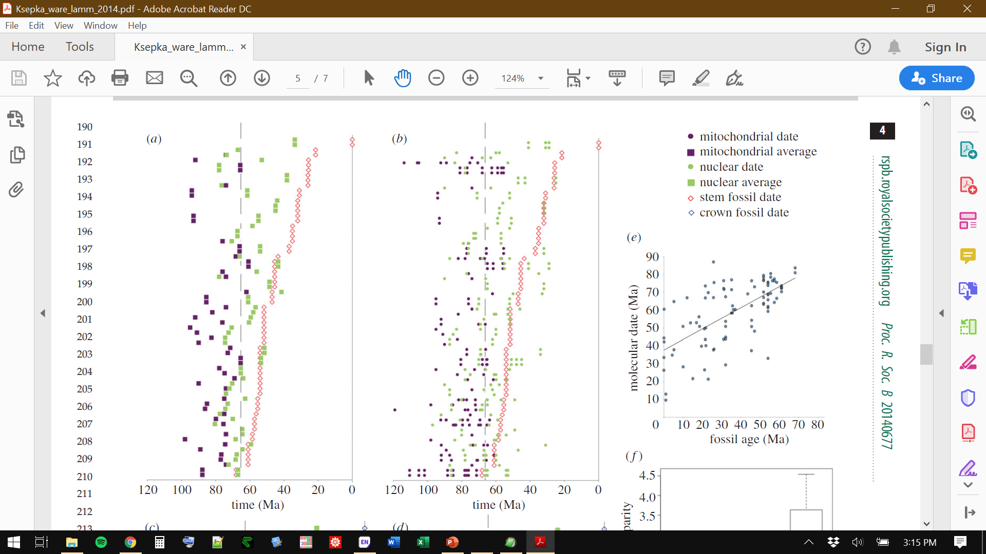
Problem with molecular clocks
Molecular clocks alone usually give unrealistically old divergence dates.
Figure 2. Disparity between fossil ages and molecular divergence dates in Aves: (b) individual molecular dates and fossil ages for stem divergences
Ksepka, D. T., J. L. Ware, and K. S. Lamm. 2014. Flying rocks and flying clocks: disparity in fossil and molecular dates for birds. Proceedings of the royal Society Biology

Slide 82
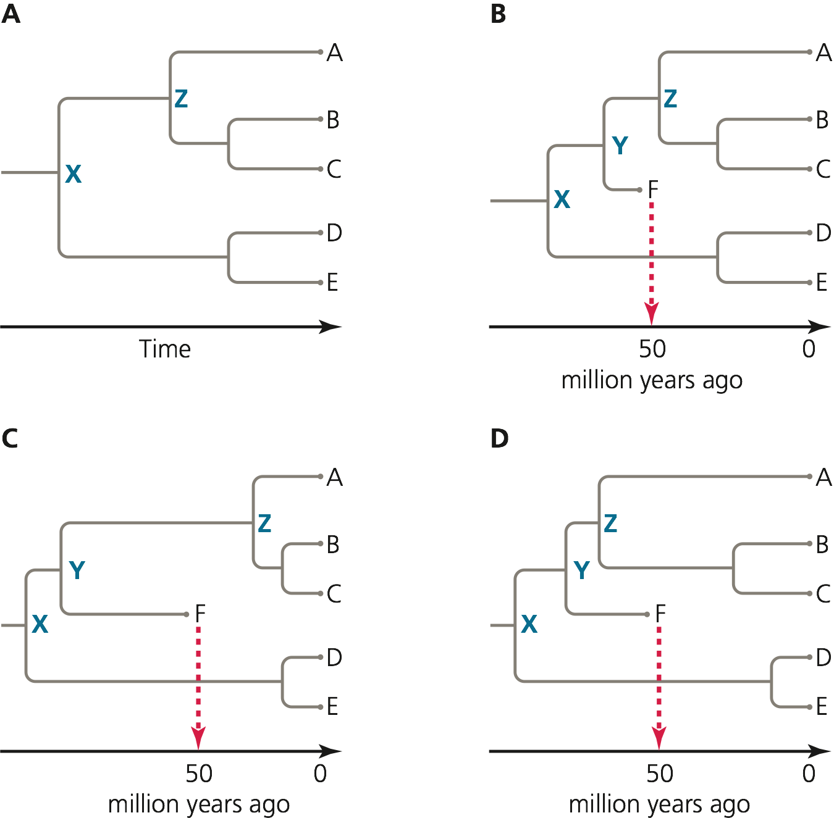
Fossils can be used to constrain divergence times

Slide 83
Molecular clocks used in conjunction with fossil calibrations yield a dated tree of life
Branch lengths = substitutions (original tree)
Branch lengths = time (dated tree)
Ages (MYA)

